Slide 1
Diamond Price Prediction
Data analysis and visualization

Slide 2
Project steps
Data Extraction
Data Cleaning
Data Analysis and visualization
Preprocessing Data
Machine Learning & Model Deployments

Slide 3
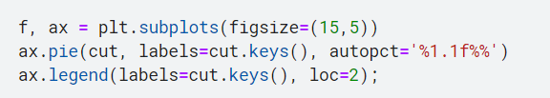
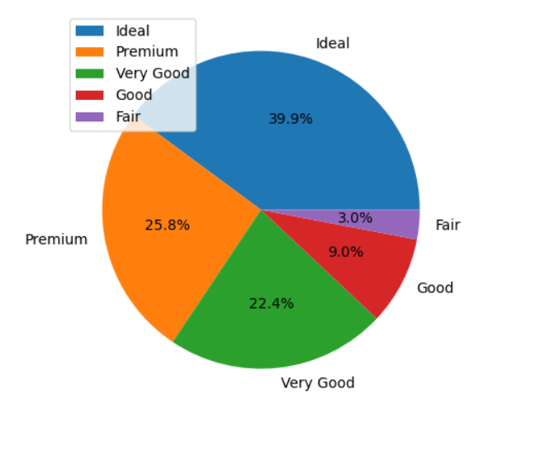
Cut types distribution

Slide 4
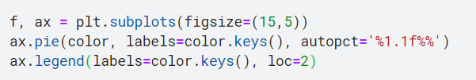
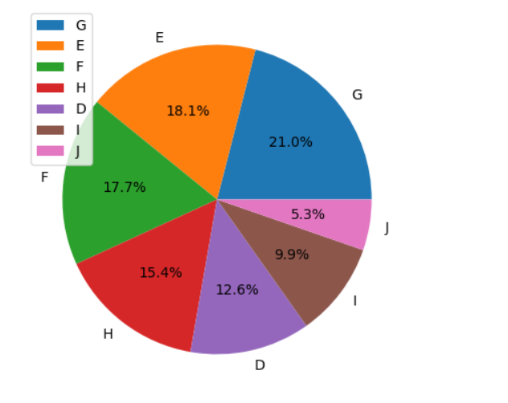
Colors distribution

Slide 5

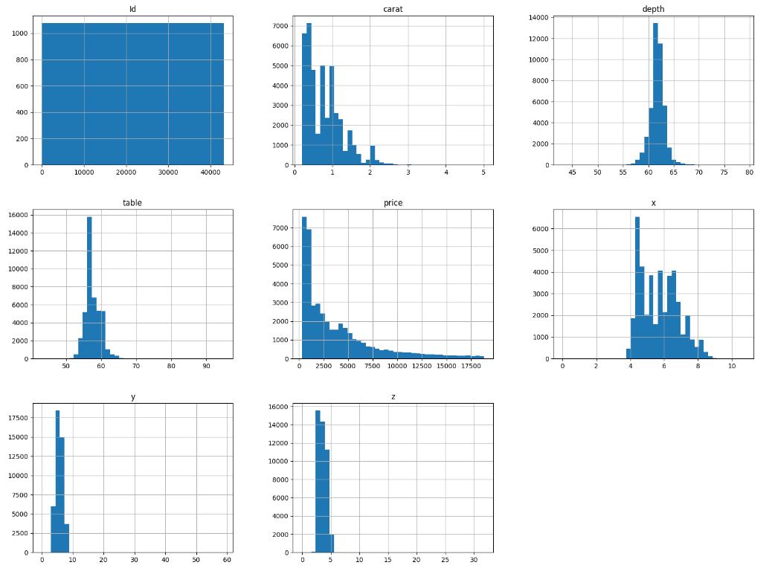
The count distribution of values of all features within train data.

Slide 6
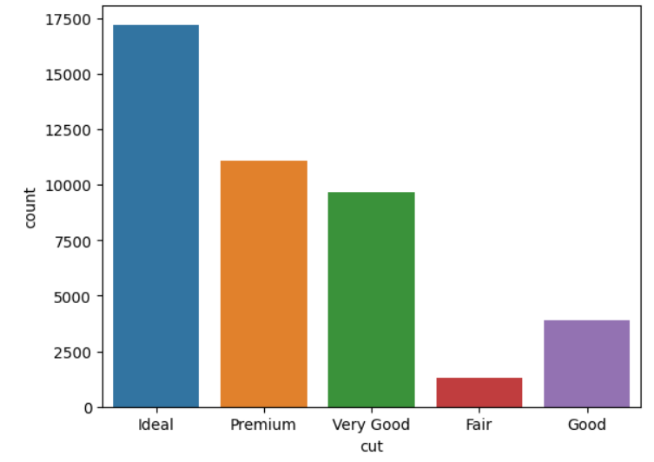
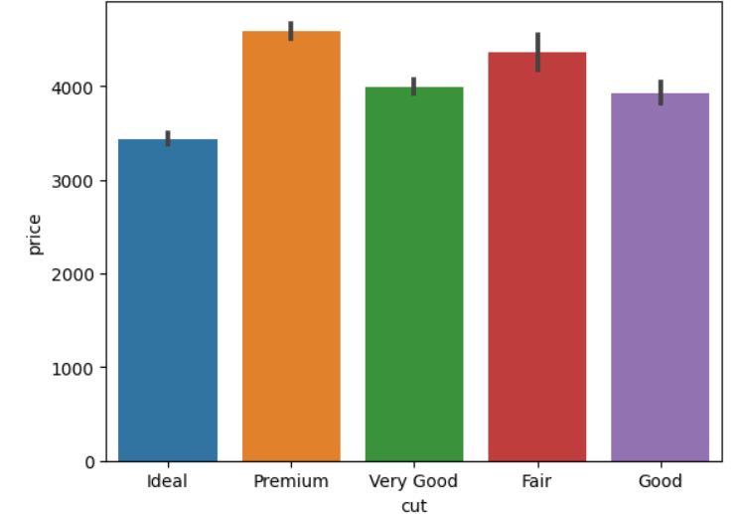
Relation between The means of each category feature and the price.

Slide 7
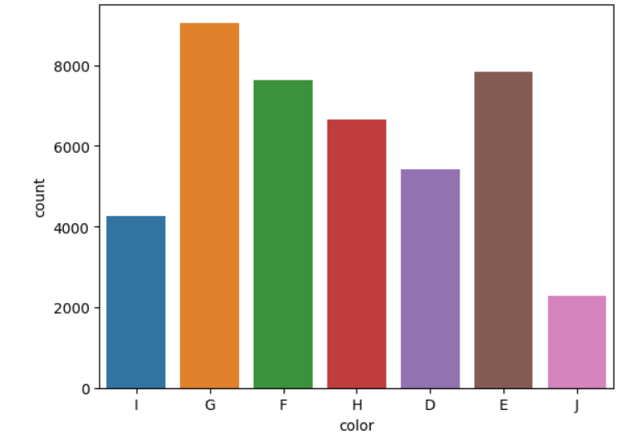
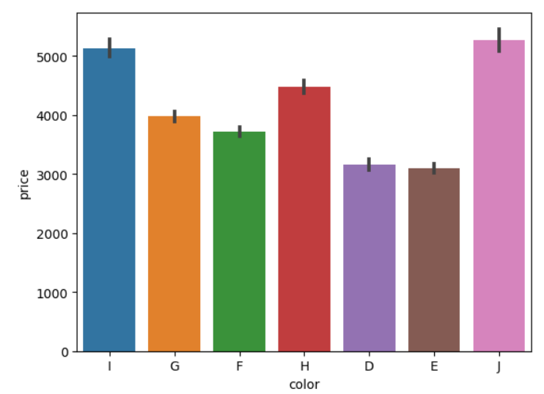
Relation between The means of each category feature and the price.

Slide 8
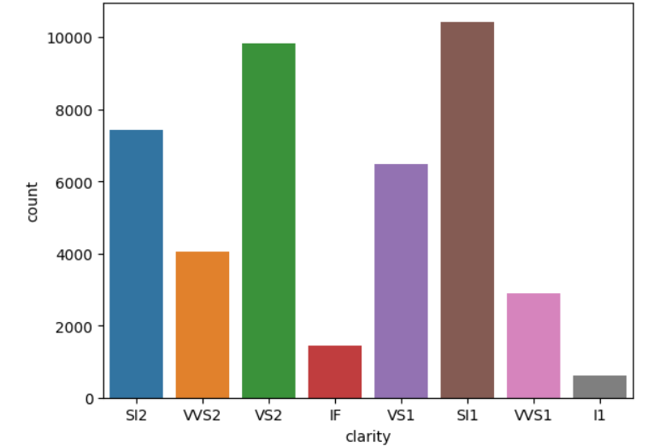
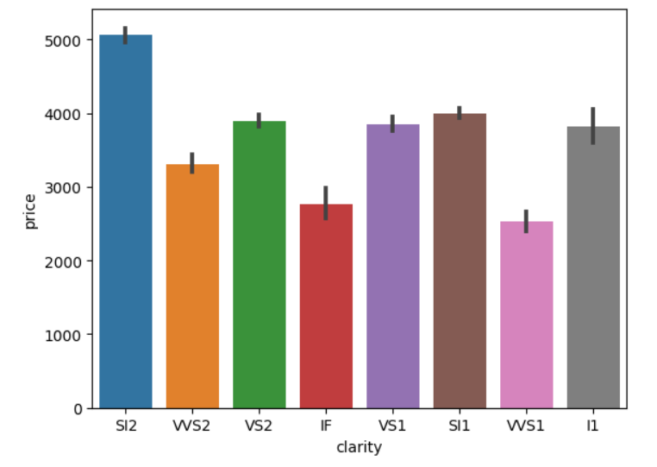
Relation between The means of each category feature and the price.

Slide 9
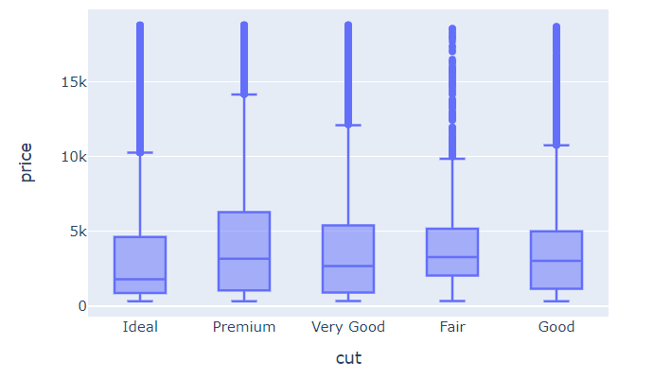
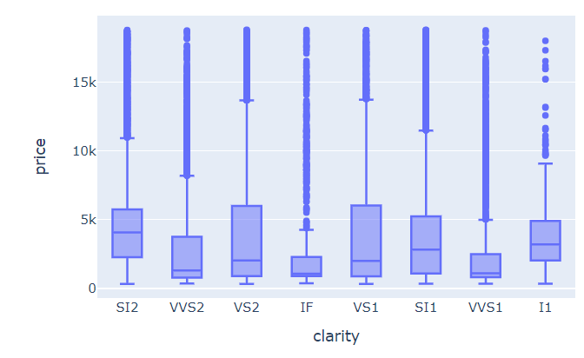
Statistical representation of the distribution of a variable through its quartiles with boxplot.

Slide 10

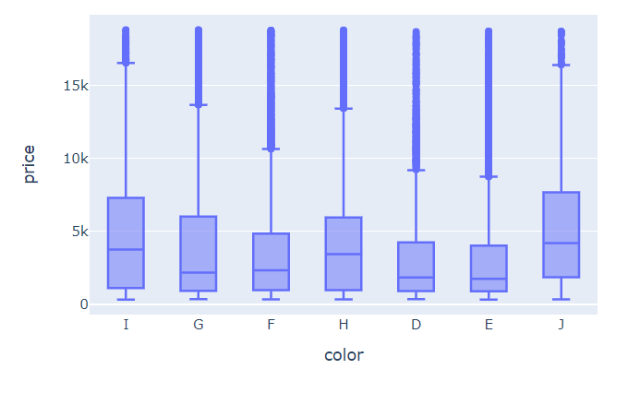
Statistical representation of the distribution of a variable through its quartiles with boxplot.

Slide 11

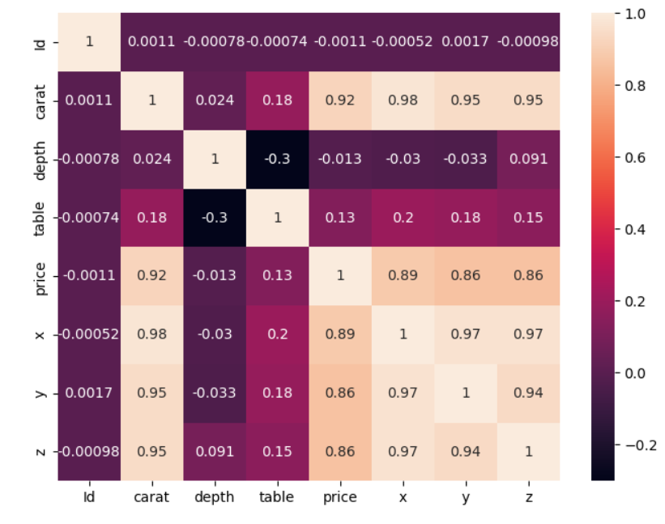
Correlation Matrix heatmap

Slide 12
Thank You For Your Attention..

